Slide 1


Slide 2


WELCOME TO KRAKOW UNIVERSITY OF ECONOMICS
IN THE WINTER SEMESTER OF THE ACADEMIC YEAR 2024/25

Slide 3

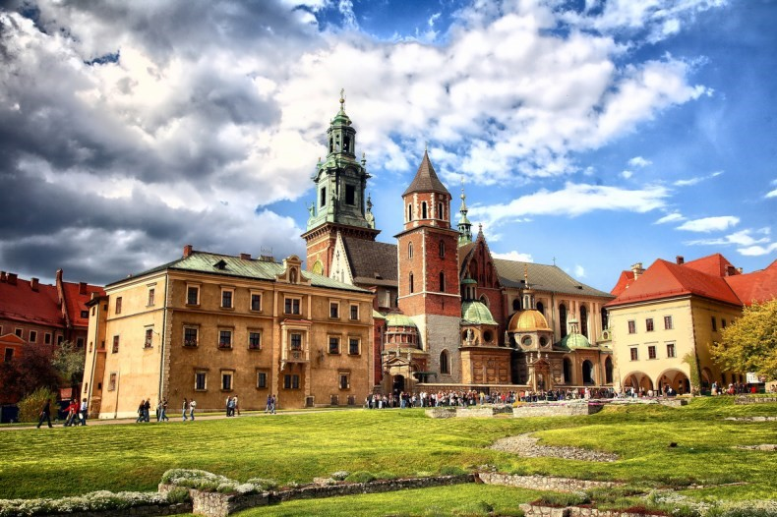
KRAKÓW – THE CITY OF STUDENTS
nearly 770 000 inhabitants
23 higher education institutions
over 1400 professors
nearly 200 000 students

Slide 4

KEY FACT ABOUT KRAKOW UNIVERSITY OF ECONOMICS
created in 1925 as the High College of Commerce
transformed into the Academy of Commerce in 1938
became Krakow University of Economics in 2007
is one of the five Polish public economics universities
is the biggest university of economic sciences in Poland
3rd largest university in Kraków
about 15 000 students
main campus in the centre of Kraków

Slide 5

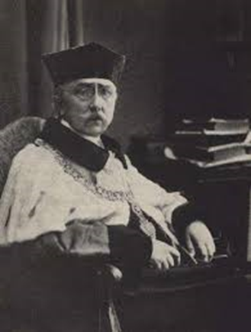
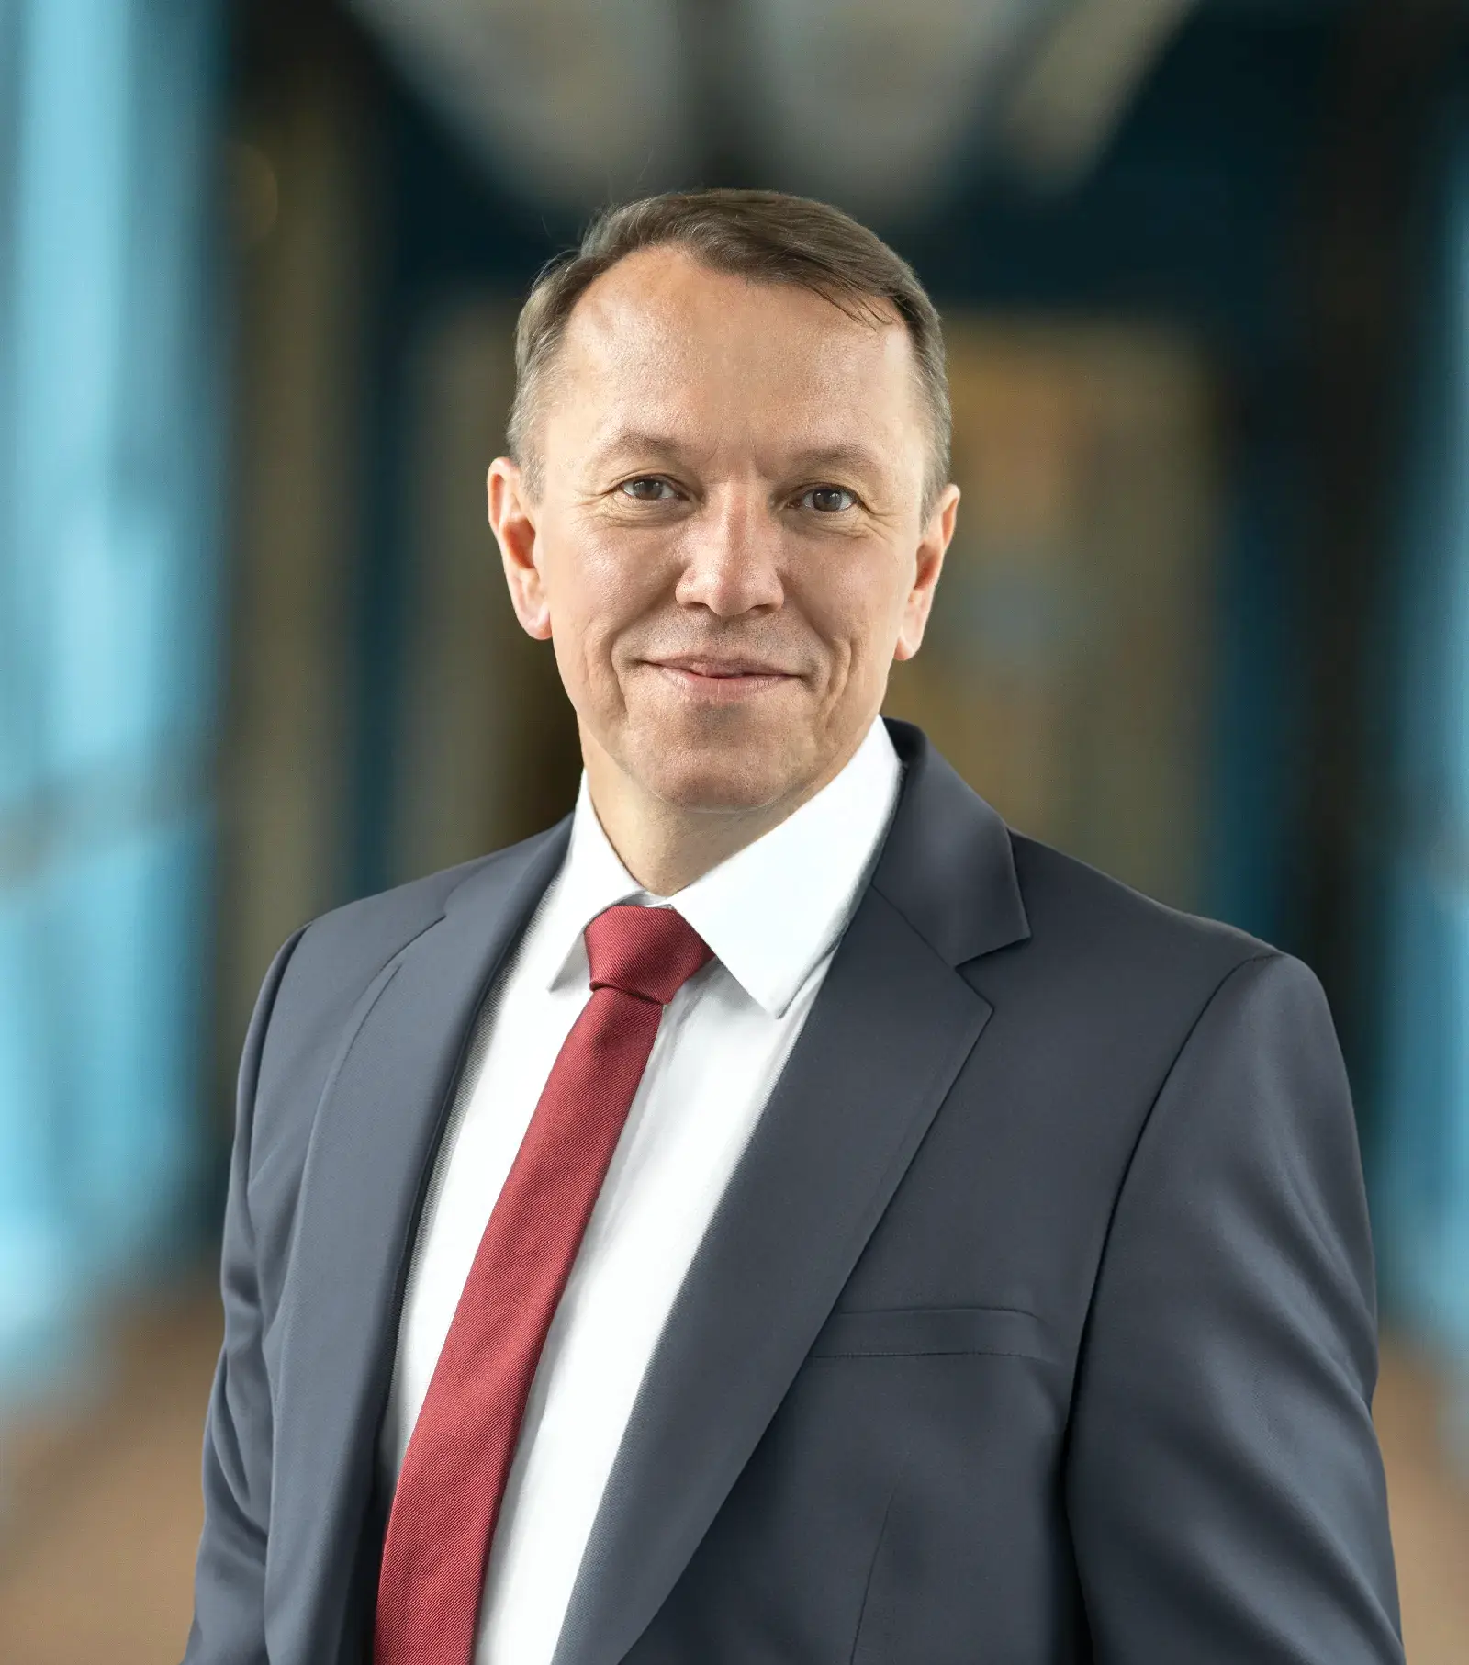
UNIVERSITY AUTHORITIES - PAST & PRESENT RECTOR
Prof. Arnold Bolland
First Rector
Dr hab. Bernard Ziębicki, prof. UEK
Present Rector

Slide 6
ACADEMIC CALENDAR WINTER SEMESTER 2024/25
Orientation Week: September 23 – September 29, 2024
Enrolment for courses: October 2 – October 11, 2024
First day of classes: October 1, 2024
Christmas/New Year’s break: December 23, 2024 – January 6, 2025
Examination session: January 27 - February 9, 2025
Retake examination session: February 17 - 23, 2025
Additional days off: October 2, 2024 (New Academic Year Inauguration)
Transcript of Records: by end of March 2025

Slide 7
INTERCULTURAL COMMUNICATION LECTURE
TUESDAY 24.09.2024
12:15 -14:00
Dr Anna Prokop-Dorner
ROOM S7, BLD. S

Slide 8
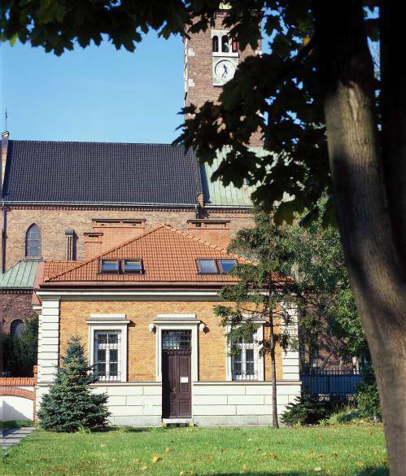
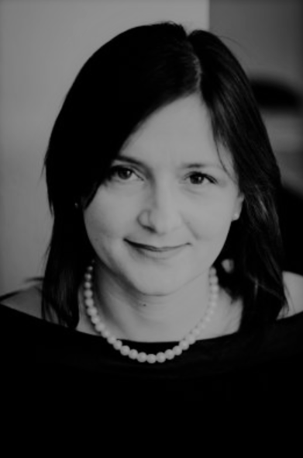

Who will you contact?
Karolina Kudla
Joanna Jackowska
Magdalena Krasowska
International Students Coordinators
Room 1.3, ground floor, Stróżówka building

Slide 9

COURSE CHOICE & SCHEDULE
The schedule will appear on our website during the Orientation Week (24.09.2024):
Plan zajęć UEK
The updated course list is also already on our website

Slide 10

UNIVERSITY STUDENT ACCOUNT
-USOSWeb (usosweb.uek.krakow.pl)
-E-Uczelnia (e-uczelnia.uek.krakow.pl) (e-paltform Moodle)
Note: in the login window for students (not lecturers)
If you have problems with passwords, use the password reminder system here: https://reset.uek.krakow.pl/
-student mail on Teams
-WiFi EDUROAM network on Campus (in this case, login is your full email address in the student.uek.krakow.pl domain, e.g. studentIDnr@student.uek.krakow.pl)
More information about logging in to UEK systems is available at the link: https://ci-pomoc.uek.krakow.pl/en/student-en

Slide 11

COURSE REGISTRATION TRACK
course choice
schedule (24.09.2024)
course registration in the USOS system
From 02/10 till 11/10
https://usosweb.uek.krakow.pl
preparing Learning Agreement (changes)
& getting it approved by the Coordinators

Slide 12

COURSE REGISTRATION TRACK
Enrollment period:
October 2 @ 8pm until October 11, 2024 @ 8pm
https://usosweb.uek.krakow.pl/
Scheme of registration:
Login: studentIDnr
Password: reset after first login
https://reset.uek.krakow.pl
HELP? https://ci-pomoc.uek.krakow.pl/en/

Slide 13

OTHER ACTIVITIES
SPORT TEAMS
HTTPS://AZS.UEK.KRAKOW.PL/
CHOIR DOMINANTA
STUDENTS ORGANIZATIONS AND SCIENTIFIC CLUBS
LANGUAGE COURSES IN THE LANGUAGE CENTRE (CJ)
LIBRARY AND JOINING THE LIBRARY
PSYCHOLOGICAL CONSULTATION IN ENGLISH

Slide 14
LEGALIZATION OF STAY OVER 3 MONTHS
Locations of foreigner service centres in Małopolska (malopolska.uw.gov.pl)
CITY TRANSPORTATION – BUSES AND TRAMS
no need to go to the MPK Office, tickets may be purchused
in one of the maschines:
AUTOMATY MPK
https://www.mpk.krakow.pl/en/prices-of-tickets

Slide 15
HEALTHCARE
HEALTHCARE IN KRAKOW – GP
THE NEAREST CLINIC IS IN RAKOWICKA 16:
Scanmed S.A.
HEALTHCARE IN KRAKÓW AND REGION

Slide 16

INTERNATIONAL PROGRAMMES OFFICE
OFFICE HOURS FOR EXCHANGE STUDENTS
MONDAY & TUESDAY & THURDSDAY FROM 11:00 TILL 13:00
ROOM 1.3 STRÓŻÓWKA BLD.
Biuro Programów Zagranicznych UEK
Joanna Jackowska jackowsj@uek.krakow.pl
Countries: Albania, Bulgaria, Croatia, Bosnia and Herzegovina, Montenegro, Czech Republic, Greece, Hungary, Portugal, Romania, Slovakia, Slovenia, Spain, Turkey, CEEPUS programme countries, Erasmus+171 partners
Magdalena Krasowska krasowsm@uek.krakow.pl
Countries: Germany, Austria, France, Italy, Switzerland, Denmark, Finland, Norway, Sweden, UK, Ireland, Iceland, Canada, USA, Vietnam, Korea, China, Japan, Erasmus+171 partners

Slide 17


